Slide 1

Evaluation of an Improved Phthalic Anhydride Facility
William Lee
Lucas Prescott
Jennifer Silva
Lily Zhong

Slide 2

Objectives
Design a facility to produce 100,000 metric tonnes/year of Phthalic Anhydride from Ortho-xylene¹
Uses of Phthalic Anhydride
Phthaleins & other dyes
Polyester resins (e.g. for paints, lacquers, fiberglass-reinforced plastics)
Insecticides
Plasticizers e.g. for PVC
Uses of Maleic Anhydride
Unsaturated polyester resins (UPSs) fiberglass-reinforced plastics
1,4-butanediol for thermoplastics
Hexahydrophthalic anhydrides for epoxy resins
Lubricating oil
Malic acid for artificial sweetening
Bailie, Richard, Whiting, Wallace, Shaeiwitz, Joseph, Turton, Richard, and Bhattacharyya, Debangsu. Analysis, Synthesis, and Design of Chemical Processes, Fifth Edition (2018). Web.
Notes:
Objectives: introduce and discuss the main objectives of your project. State the importance
and applications of your main product(s). Provide a process flow diagram of the process(es)
to be evaluated. Identify products, raw materials, byproducts and waste streams as well as
key specifications (e.g., purity associated to feedstocks and products, production scale).
Describe key parts of your process(es), highlighting critical unit operations and key
specifications (i.e., operating conditions).

Slide 3

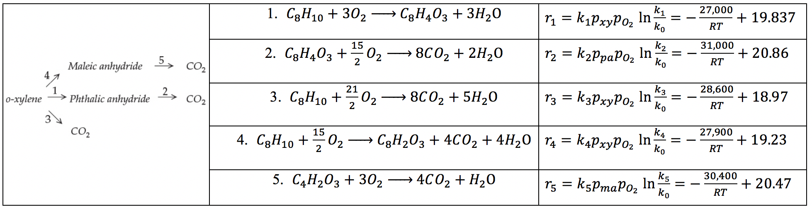
Objectives: Reactions and Kinetics
Bailie, Richard, Whiting, Wallace, Shaeiwitz, Joseph, Turton, Richard, and Bhattacharyya, Debangsu. Analysis, Synthesis, and Design of Chemical Processes, Fifth Edition (2018). Web.

Slide 4
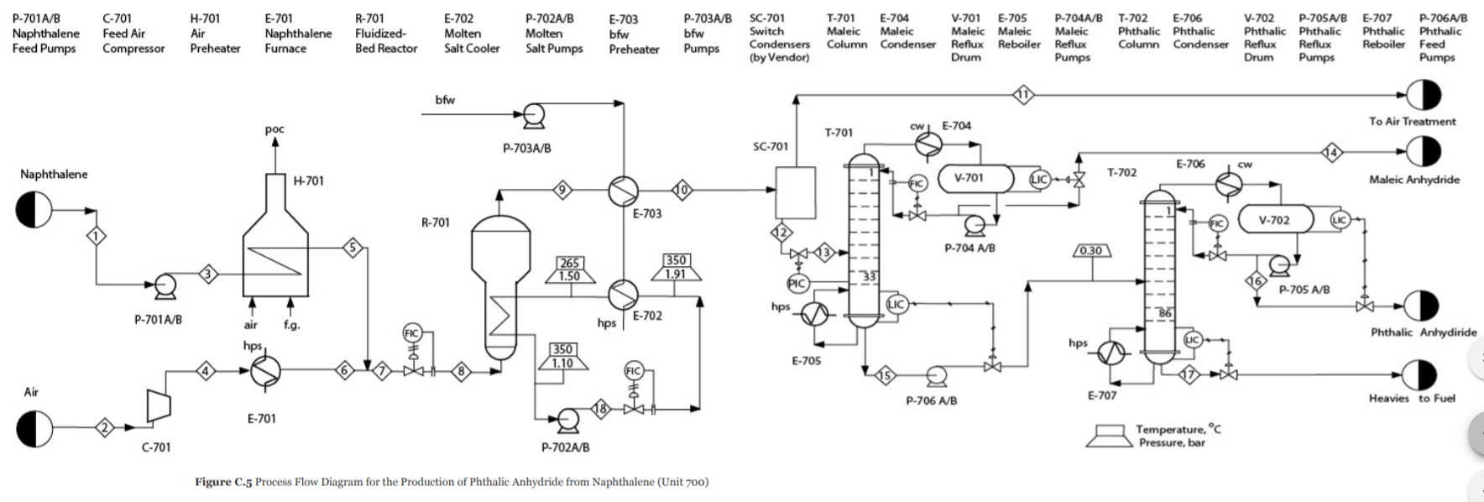
Objectives
Optimize o-xylene (100°C and 1.1 bar) reaction in a PBR / FBR
Modeled as a shell-and-tube PFR and an isothermal PFR with 10% bypass, respectively
Attain 99.9 wt% Phthalic Anhydride and 95.0 wt% Maleic Anhydride product streams
Bailie, Richard, Whiting, Wallace, Shaeiwitz, Joseph, Turton, Richard, and Bhattacharyya, Debangsu. Analysis, Synthesis, and Design of Chemical Processes, Fifth Edition (2018). Web.
Notes:
Objectives: introduce and discuss the main objectives of your project. State the importance
and applications of your main product(s). Provide a process flow diagram of the process(es)
to be evaluated. Identify products, raw materials, byproducts and waste streams as well as
key specifications (e.g., purity associated to feedstocks and products, production scale).
Describe key parts of your process(es), highlighting critical unit operations and key
specifications (i.e., operating conditions).

Slide 5
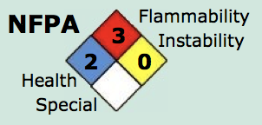
Major Hazards and Health Effects of O-xylene
General Description: A colorless watery liquid with a sweet odor. Less dense than water. Insoluble in water²
Reactive Group(s): Hydrocarbons, aromatic
Reactivity Alert(s): Highly Flammable
Health Hazards:³
Vapors cause headache and dizziness
Liquid irritates eyes and skin
Inhalation: severe coughing, distress, and rapidly developing pulmonary edema
Ingested: nausea, vomiting, cramps, headache, coma; can be fatal
Kidney and liver damage can occur
Reactivity Profile:
Exothermic reaction with oxygen at ambient temperatures
Intense, violent, or explosive reaction
2. https://www.aiche.org/ccps/resources/chemical-reactivity-worksheet-40
3. https://onlinelibrary.wiley.com/doi/full/10.1002/prs.11833
Notes:
OSHA 1910.119 and Materials Safety Data Sheets (MSDS): does your process need to
comply with OSHA 1910.119? For the main chemicals in your process, summarize major
hazards and health effects, as well as known incompatible materials.

Slide 6
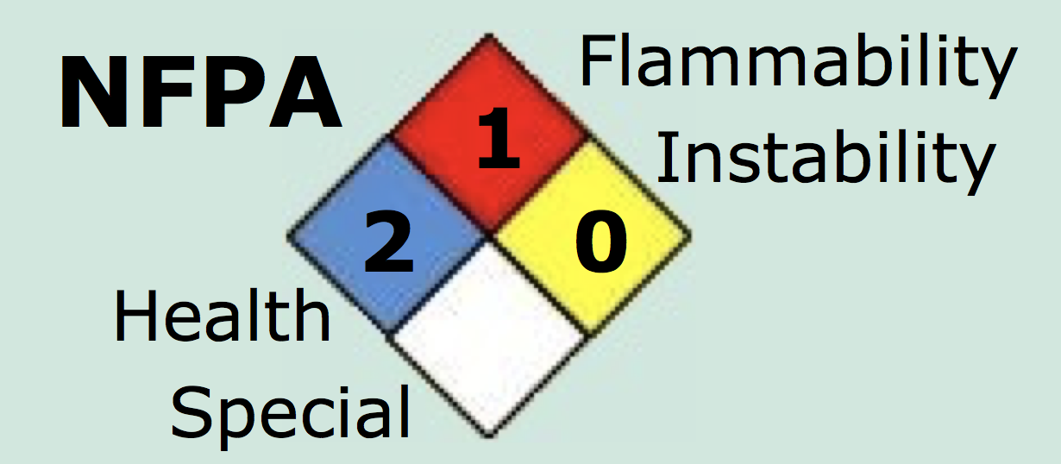
Major Hazards and Health Effects of Phthalic Anhydride
General Description: Colorless to white lustrous solid needles with a mild distinctive odor. Melting point 64°F Flash point 305°F. Used in the manufacture of materials such as artificial resins.²
Reactive Group(s): Anhydrides
Health Hazards:³
Solid irritates skin and eyes; coughing and sneezing
Liquid: severe thermal burns
Reactivity Profile:
Reacts exothermically with water
Incompatible with acids, strong oxidizing agents, alcohols, amines, and bases
Exothermic nitration with fuming nitric acid-sulfuric acid
Mixtures of phthalic anhydride and anhydrous CO₂ explode violently if heated
2. https://www.aiche.org/ccps/resources/chemical-reactivity-worksheet-40
3. https://onlinelibrary.wiley.com/doi/full/10.1002/prs.11833
Notes:
OSHA 1910.119 and Materials Safety Data Sheets (MSDS): does your process need to
comply with OSHA 1910.119? For the main chemicals in your process, summarize major
hazards and health effects, as well as known incompatible materials.

Slide 7
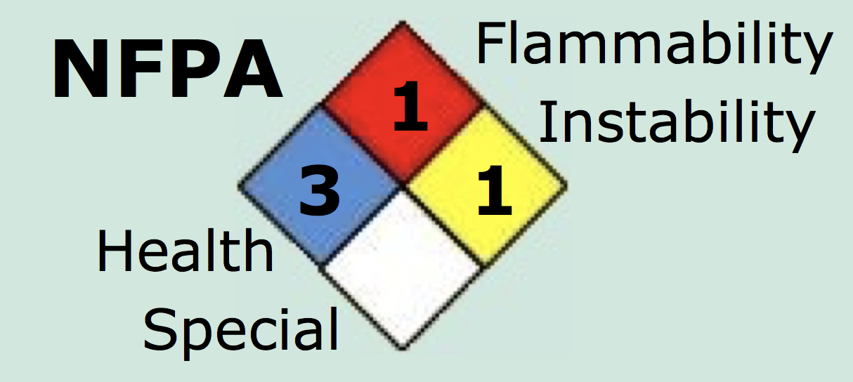
Major Hazards and Health Effects of Maleic Anhydride
General Description: Colorless crystalline needles. Melts at 113°F. Flash point 218°F. Autoignition temperature 890°F.²
Reactive Group(s): Anhydrides; Hydrocarbons, Aliphatic Unsaturated
Reactivity Alert(s): Known Catalytic Activity; Water-Reactive
Health Hazards:³
Inhalation: coughing, sneezing, throat irritation.
Skin contact: irritation and redness
Vapors:severe eye irritation; photophobia and double vision
Reactivity Profile:
Reacts vigorously on contact with oxidizing materials
Exothermic reaction with water or steam
Undergoes violent exothermic decomposition reactions, producing carbon dioxide
2. https://www.aiche.org/ccps/resources/chemical-reactivity-worksheet-40
3. https://onlinelibrary.wiley.com/doi/full/10.1002/prs.11833
Notes:
OSHA 1910.119 and Materials Safety Data Sheets (MSDS): does your process need to
comply with OSHA 1910.119? For the main chemicals in your process, summarize major
hazards and health effects, as well as known incompatible materials.
A 0.1% solution of pyridine (or other tertiary amine) in maleic anhydride at 185°C gives an exothermic decomposition with rapid evolution of gas. Maleic anhydride is known as an excellent dienophile in the Diels-Alder reaction to produce phthalate ester derivatives. These reactions can be extremely violent, as in the case of 1-methylsilacyclopentadiene. Maleic anhydride undergoes a potentially explosive exothermic Diels-Alder reaction with 1-methylsilacyclopenta-2,4-diene at 150C [Barton, T. J., J. Organomet. Chem., 1979, 179, C19], and is considered an excellent dieneophile for Diels-Alder reactions. "Maleic Anhydride, Maleic Acid, and Fumaric Acid." Kirk-Othmer Encyclopedia of Chemical Technology. John Wiley & Sons, Inc. 2005].

Slide 8
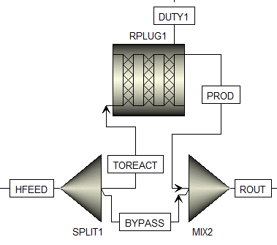
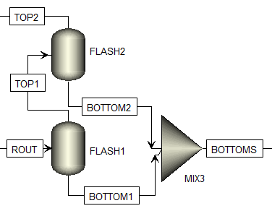
Aspen Plus Simulation Design Choices
Fluidized Bed Reactor
Switch Condenser Simplification
Notes:
Preliminary Aspen Plus simulation results: show anything you have done at this stage.
What thermodynamic model are you using? Describe which Aspen Plus blocks you have
used to model all relevant unit operations (reactors, columns, separation units, compressors,
etc.) Describe any problems/issues/roadblocks you might be having when modeling your
process in Aspen Plus.

Slide 9
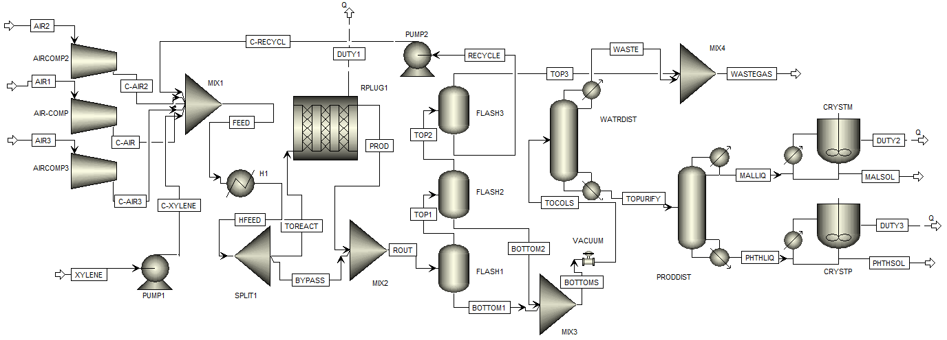
Aspen Plus Simulation Results
Process Flow Diagram
105,558 tonnes of phthalic anhydride and 1,690 tonnes of maleic anhydride per year.
Products are at room temperature and atmospheric pressure.
Notes:
Preliminary Aspen Plus simulation results: show anything you have done at this stage.
What thermodynamic model are you using? Describe which Aspen Plus blocks you have
used to model all relevant unit operations (reactors, columns, separation units, compressors,
etc.) Describe any problems/issues/roadblocks you might be having when modeling your
process in Aspen Plus.

Slide 10
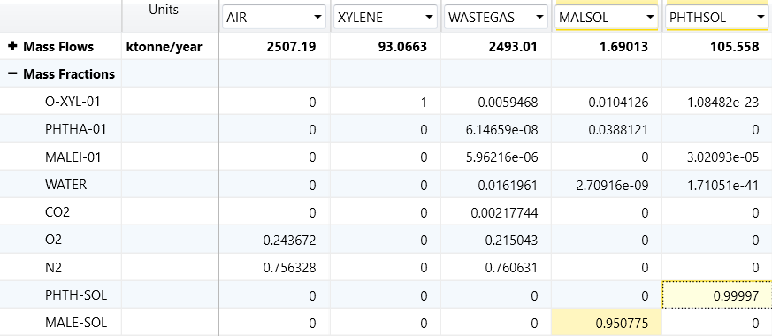
Aspen Plus Simulation Results
Purity of Products:
Notes:
Preliminary Aspen Plus simulation results: show anything you have done at this stage.
What thermodynamic model are you using? Describe which Aspen Plus blocks you have
used to model all relevant unit operations (reactors, columns, separation units, compressors,
etc.) Describe any problems/issues/roadblocks you might be having when modeling your
process in Aspen Plus.

Slide 11
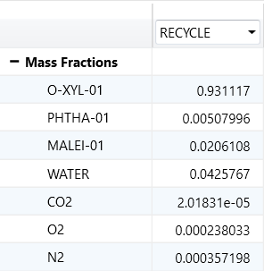
Aspen Plus Simulation Design Choices
SRK Thermodynamic Model Stream with STEAMNBS free water method
Recycle stream to reduce raw material waste
Fluidized Bed Reactor | Packed Bed Reactor (Shell-and-Tube)
Uniform temperature profile Higher output per unit of investment Higher product purity can be obtained Efficient heat of reaction recovery | Tube diameters must be small to avoid hot spots and catalyst damage Charging and replacing catalyst is tedious Heat recovery from packed bed reactors is difficult
4. *Wang, Jyue-Sheng, et al. Oxidation of ortho-xylene to phthalic anhydride using a fluidized bed catalysis, 1965.
Notes:
Preliminary Aspen Plus simulation results: show anything you have done at this stage.
What thermodynamic model are you using? Describe which Aspen Plus blocks you have
used to model all relevant unit operations (reactors, columns, separation units, compressors,
etc.) Describe any problems/issues/roadblocks you might be having when modeling your
process in Aspen Plus.

Slide 12

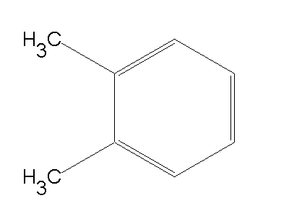
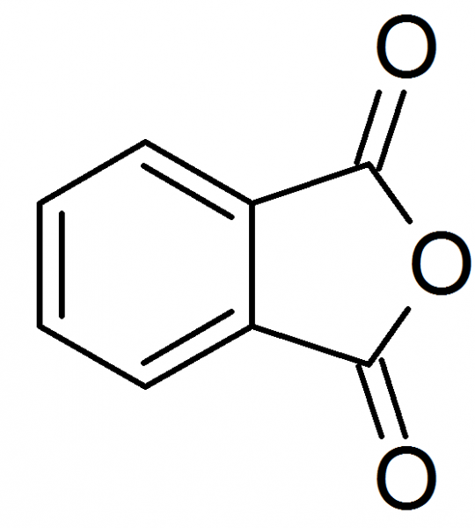
Economic Evaluation
Total Project Capital Cost: $44,519,700
Revenue: $65,461,300 in 10 yrs
Variable Costs of Production
Raw Materials (O-xylene and Air): $118,905,000 / yr
O-xylene: $1.40 / kg
Utilities: $171,802 / yr
Fixed Costs of Production
Total Operating Cost: $131,227,000 / yr
Plant Overhead Cost: $720,000 / yr
Operating Labor Cost: $1,080,000 / yr
Maintenance Cost: $360,000 / yr
5. “C6: The Price of Para and Ortho Xylene.” Duncan Seddon & Associates Pty. Ltd., 2013, http://www.duncanseddon.com/docs/pdf/c6-the-price-of-para-and-ortho-xylene.pdf
Notes:
Estimate capital costs
Total Project Capital Cost: $74950700/yr
Estimate of revenues and production costs
Estimate of revenues: $50097900 in 10 yrs
Variable costs of production (raw materials, utilities, consumables, effluent disposal)
Raw Materials (O-xylene and Air) : $118905000/yr
O-xylene: $1.40 / kg
Utilities: $8901810/yr
Fixed costs of production (operating labor, supervision, salary overhead, maintenance)
Operating Cost: $142659000/yr
Supervision Cost: $280000/yr
Maintenance Cost: $1410000/yr
Summarize margins and profits
Total Product Sales: $153713000/yr
Phthalic Anhydride: $1.61/yr
Maleic Anhydride: $1.42/yr
Economic evaluation
Net Present value: $-45651400/yr
Discounted cash flow rate of return (DCFROR or IRR): 0%
Economic life of project: 10 yrs
Country basis: US

Slide 13

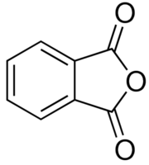
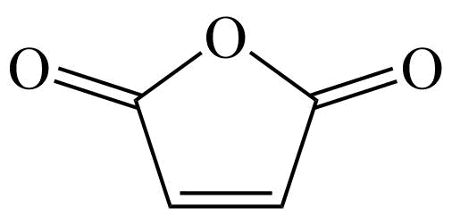
Economic Evaluation
Total Product Sales: $153,713,000 / yr
Phthalic Anhydride: $1.61 / kg
Maleic Anhydride: $1.42 / kg
Economic Evaluation
Economic life of project: 10 yrs
Payout Period: 9.55 yrs
Internal Rate of Return: 21.48%
NPV at 10 years: $4,727,550
Country basis: US
6. “Phthalic Anhydride Price History & Forecast.” Intratec Solutions, Intratec Solutions, LLC, 2017, https://www.intratec.us/chemical-markets/maleic-anhydride-price
7. “Maleic Anhydride Price History & Forecast.” Intratec Solutions, Intratec Solutions, LLC, 2017, https://www.intratec.us/chemical-markets/maleic-anhydride-price
Notes:
Discounted cash flow rate of return

Slide 14

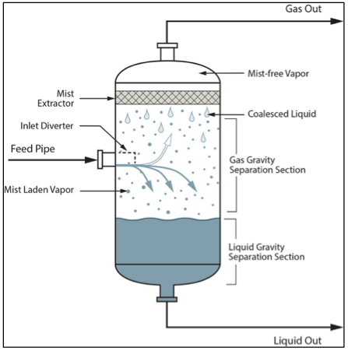
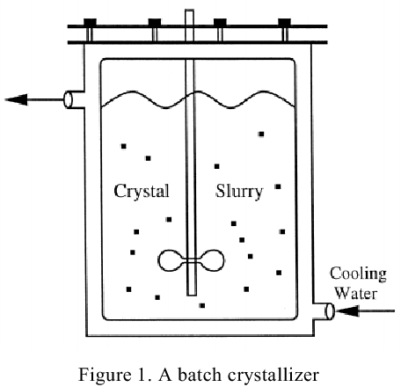

Conclusions
Increase plant profitability with a more optimal catalyst
Additional Flash Separator, Recycle Stream, and Crystallizer

Slide 15
Questions?

